Slide 1



Temporal data with tsibble and fable
Oskar Krafft
Justus v. Samson-Himmelstjerna

Slide 2


Outlook
tsibble: tidy data analysis workflow for time series data
tidy data frames combined with temporal data
fable: forecasting with tables for time series data
Provide forecasts with time distributions, not intervals.
Specify
Tidy
Visualise
Estimate
Forecast
Evaluate

Slide 3
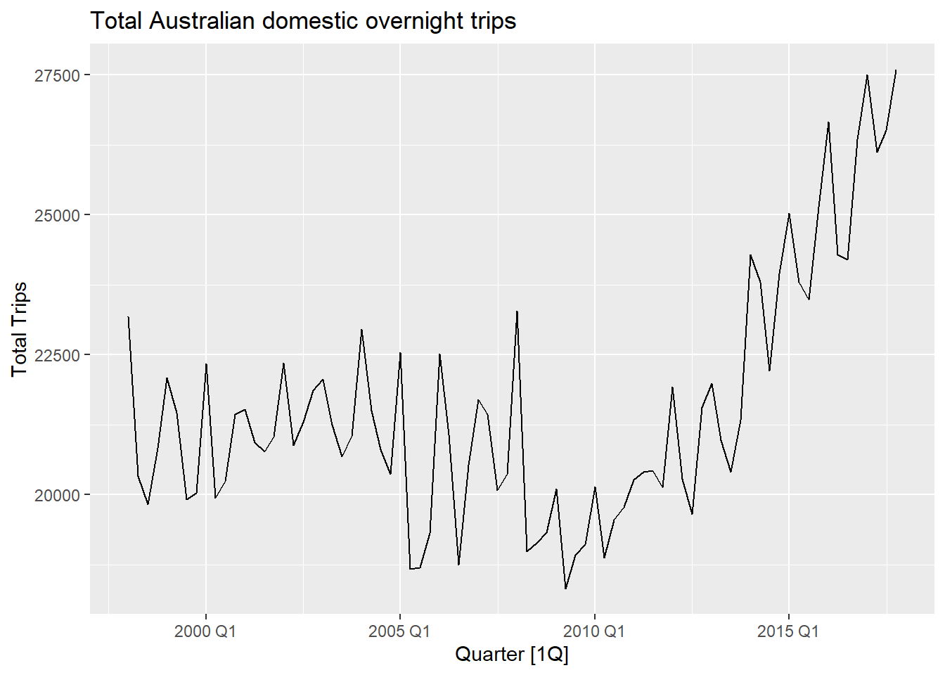
Vocabulary for time series analysis
Trends
Long-term overall Increase or decrease in the Data
Does not have to be linear
Seasonal
Data affected by seasonal factors
Seasonality has fixed periods
Cyclic
Rises and falls of unknown frequency
For example economic cycles

Slide 4
Grammar of tsibble
Index is a variable with inherent ordering from past to present.
Key is a set of variables that define observational units over time.
Each observation should be uniquely identified by index and key.
Interval computed from index, ranging from year to nanosecond, from numerics to ordered factors.
Intervals can be Regular as well as Irregular
Interval | Class
Annual | integer/double
Quarterly | yearquarter
Monthly | yearmonth
Weekly | yearweek
Daily | Date/difftime
Subdaily | POSIXt/difftime/hms
Notes:
A time series can be thought of as a list of numbers (the measurements), along with some information about what times those numbers were recorded (the index).
This information can be stored as a tsibble object in R.
The tsibble package provides a data class of tbl_ts to represent tidy temporal data. A tsibble consists of a time index, key, and other measured variables in a data-centric format, which is built on top of the tibble.
Tsibble supports arbitrary index classes, as long as they can be ordered from past to future.
In comparison to tibble the column of data specifying the observation’s measurement time is now actually used in the data

Slide 5
Common verbs used in tsibble
as_tsibble() → Coerce Data to a tsibble object
count_gaps() → Count implicit gaps
fill_gaps() → Turn implicit missing values into explicit missing values
has_gaps() → Show if a tsibble has implicit gaps
filter_index() → filtering time index for a tsibble
index_by() → Group by time index and collapse with summarise()
group_by_key(). → Group by key variables

Slide 6
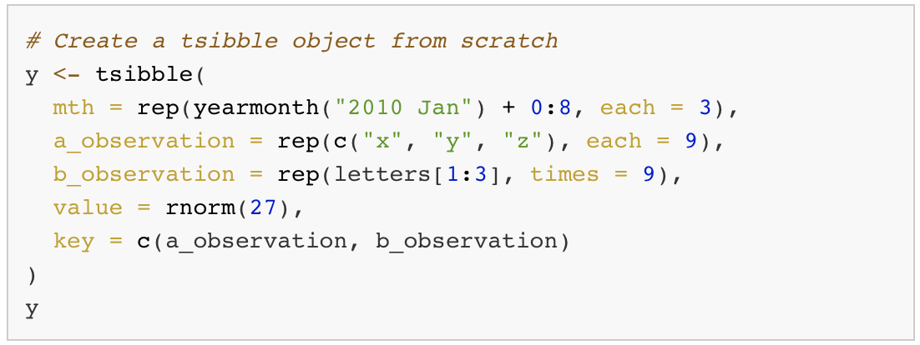
Data preparation and manipulation (tsibble)

Slide 7
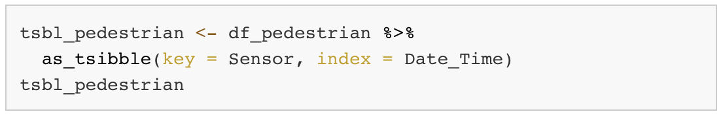
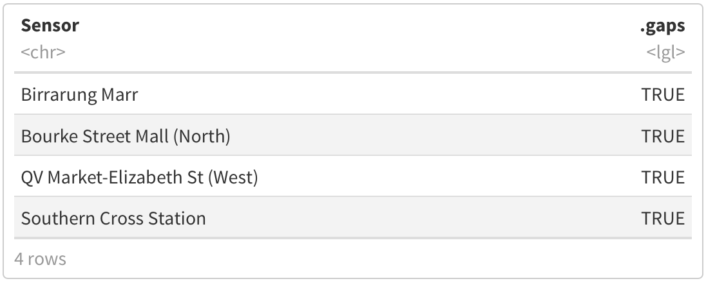
Data preparation and manipulation (tsibble)

Slide 8
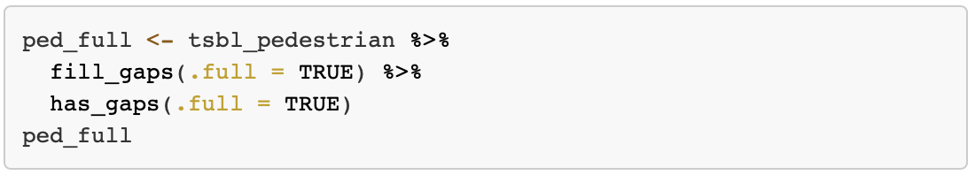
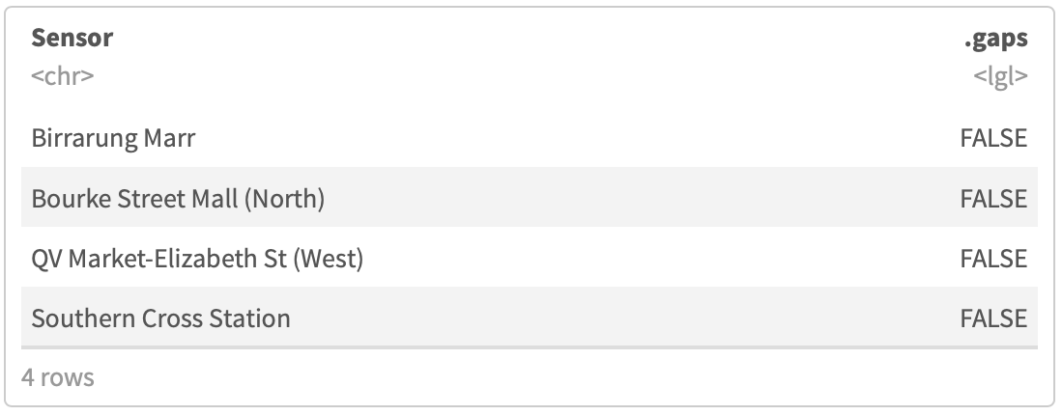
Data preparation and manipulation (tsibble)

Slide 9

A forecasting workflow for time series data
Data preparation and manipulation
Model specification and estimation
Forecasting and choosing the best Model

Slide 10
The syntax of fable
R> Transform(y) ~ {model specification}
Left Hand Side - Response | Right Hand Side - Specials
Defines the response variable from the Data | Model specific special functions
Specification of transformations (which are automatically back-transformed) | Several models at the same time possible

Slide 11
Common verbs used in fable
Model() → Model specification
ETS() → Exponential smoothing state space model
ARIMA() → Autoregressive integrated moving average model
TSLM() → Linear model with time series components
forecast() → Forecast Data using the specified model
glance() → Construct a single row summary of the model
accuracy() → Summarise the performance of the model using accuracy measures

Slide 12
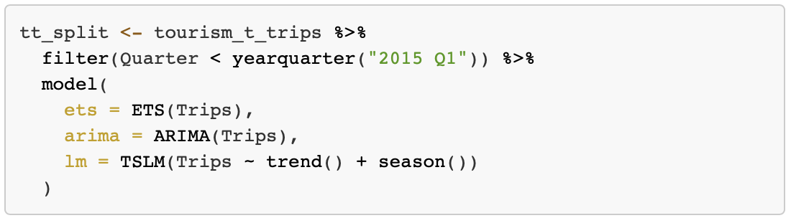
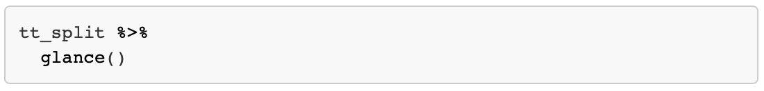
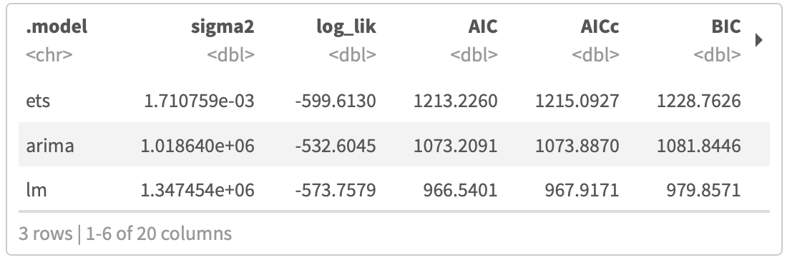
Model specification and forcasting (fable)
Notes:
.
Models in fable are specified using model functions
(y ~ X)
Response variable(s) are specified on the left of the formula
Structure of the model is written on the right
One or more model specifications can be estimated using the model() function.

Slide 13
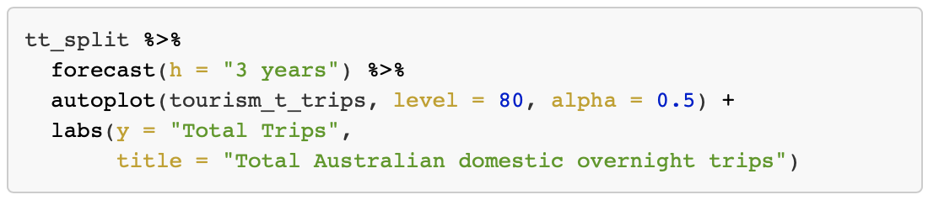
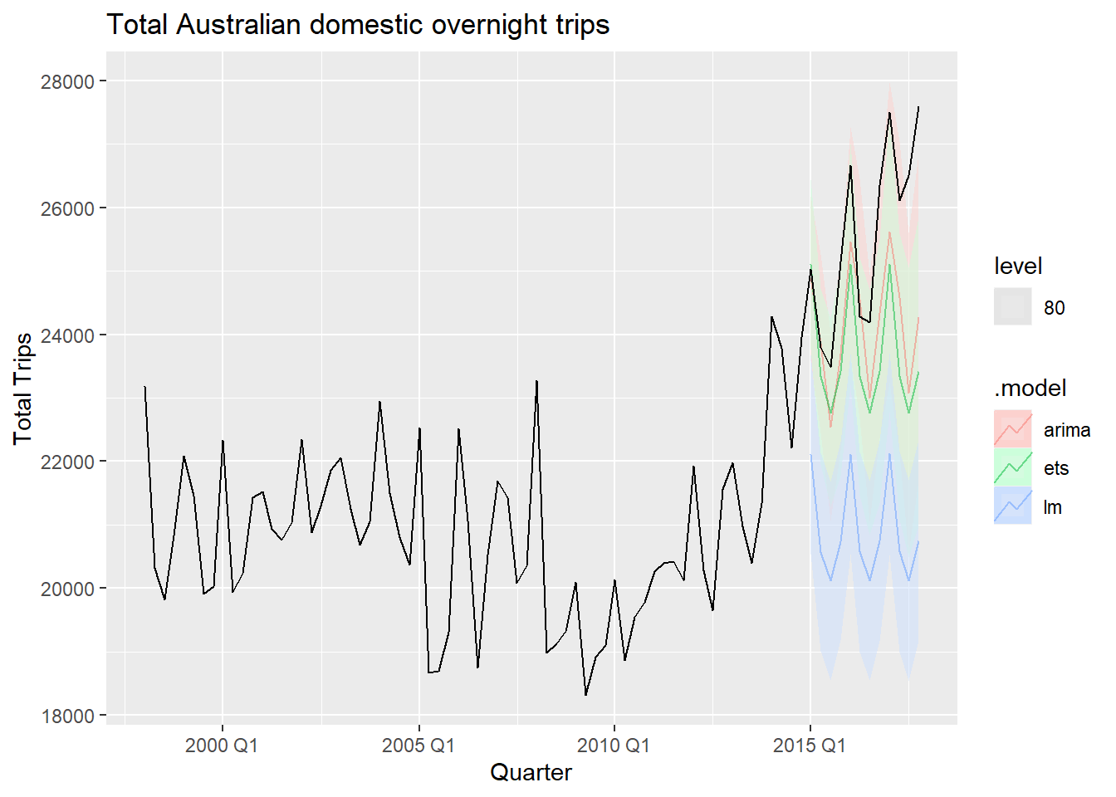
Producing forecasts
Notes:
.

Slide 14
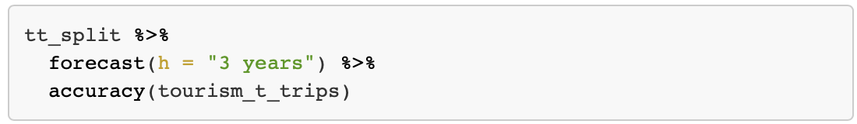
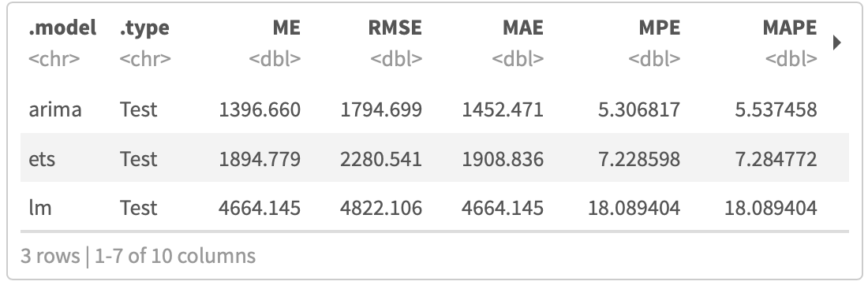
Producing forecasts
Notes:
.

Slide 15
Further Reading
https://tsibble.tidyverts.org
https://fable.tidyverts.org
http://cran.nexr.com/web/packages/tsibble/vignettes/intro-tsibble.html
https://cran.r-project.org/web/packages/tsibble/tsibble.pdf
https://cran.r-project.org/web/packages/fable/fable.pdf
https://www.mitchelloharawild.com/blog/fable/
https://otexts.com/fpp3/

Slide 16
